Slide 1
Grid Computing
การประมวลผลแบบกริด

Slide 2
Grid Computing
What is Grid
Motivation of Grid
Grid Architecture
Grid Security
Grid Standard
Tool that implement Grid

Slide 3
What is Grid
Collection of distributed computing resources available over a local or wide area network.
Appear to an end user or application as one large virtual computing system.
Create virtual dynamic organizations through secure, coordinated resource-sharing among individuals, institutions, and resources.

Slide 4
Types of Grids
Computational Grid
Scavenging Grid
Data Grid

Slide 5
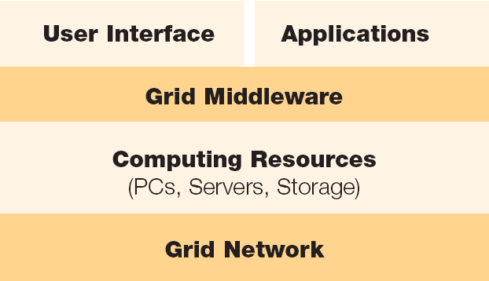
Grid Architecture

Slide 6
Grid Security
Authentication
Authorization
Encryption
Nonrepudiation
Single Sign-on
Delegation

Slide 7
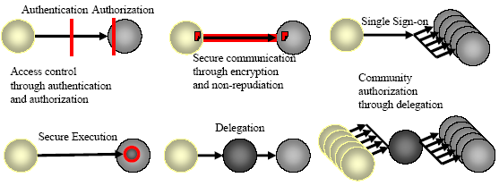
Grid Security

Slide 8
Grid Standard
Global Grid Forum (GGF)
OGSA (Open Grid Service Architecture)
  Blue Print of Middleware
  Include Web Service Technology
  Define Grid Service
OGSI (Open Grid Service Infrastructure)
  Specification of Middleware

Slide 9
Grid Service Framework
Every grid service is a web service! with additional standard capabilities by Open Grid Services Architecture (OGSA)
Open Grid Services Interface (OGSI) specifies capabilities defined in OGSA
Globus Toolkit (GT3) is an implementation of OGSI.

Slide 10
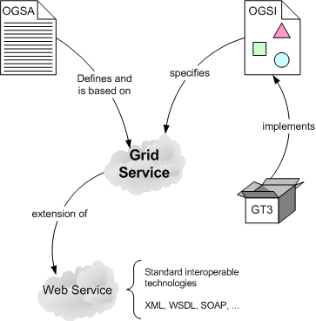
OGSA / OGSI / Web Service Relation

Slide 11
Grid Service / Web Service
Grid Service extend from Web Service and OGSI
  Stateful and potentially transient service
  Lifecycle Management
  Service Data
  portType Extension
  GSH (Grid Service Handle)
  GSR (Grid Service Reference)

Slide 12
GT3: Grid Middleware
Globus Toolkit 3 (GT3)
  Java Implementation
  OGSI Implementation
  Include Web Service Technology

Slide 13
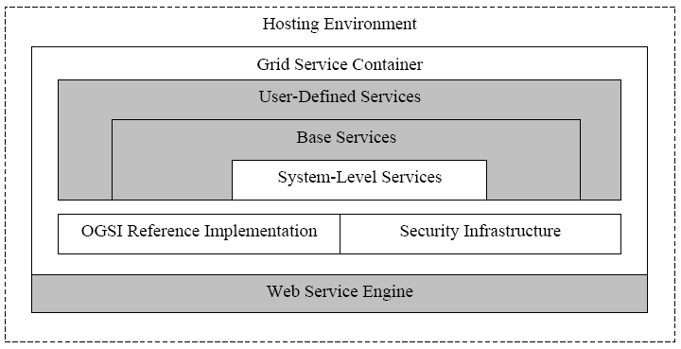
Globus Toolkit 3 Core

Slide 14
GT3 Service
Data Management Service
  GridFTP
  Reliable File Tranfer (RFT)
Resource Management
  Grid Resource Allocation and Manager (GRAM)
Security Service
  Grid Security Infrastructure (GSI)
  Community Authorization Service (CAS)

Slide 15
How to implement Grid Service
5 Step to implement Grid Service
  1: Define service interface (GWSDL)
  2: Implement service (JAVA)
  3: Define the deployment parameter (WSDD)
  4: Create a GAR File (Apache Ant)
  5: Deploy service into grid service container (Apache Ant)

Slide 16
Parallel Computing
A large collection of processing elements that can communicate and cooperate to solve large problems quickly
A form of information processing which uses concurrent events during execution

Slide 17
Flynn’s Model of Computation
Any computer, whether sequential or parallel, operates by executing instructions on data.
  a stream of instructions (algorithm) tells the computer what to do.
  a stream of data (input) is affected by these instructions.
Depending on whether there is one or several of these streams, Flynn’s model defines four classes of computers

Slide 18
Flynn’s Model
Data Streams
 | Single | Multiple
Single | Single Instruction Single Data | Single Instruction Multiple Data
Multiple | Multiple Instruction Single Data | Multiple Instruction Multiple Data
Instruction Streams
Parallel Computing

Slide 19
Implement Grid System by GT3
System Design
  Use 4 PC :
    X1 = 161.246.6.102 CPU=2.4 GHz Ram=512 MB
    X2 = 161.246.6.124 CPU=1.8 GHz Ram=512 MB
    X3 = 161.246.6.93 CPU=1.6 GHz Ram=512 MB
    X1 implement as Authentication Server
    All Machine contain Matrix Service and Matrix Client

Slide 20
Install GT3
Software
  Linux Redhat 9
  Java j2sdk1.4.2_04
  Apache ant 1.6.1
  Junit 3.8.1
  Globus toolkit gt3.2.1

Slide 21
Install Gt3 step-by-step
Install all support software
  Java
  Apache
  Junit
Set path of software
  JAVA_HOME
  ANT_HOME

Slide 22
Install Gt3 step-by-step (cont.)
Create user
  Root – manage all of host environment
  Globus – manage globus environment
  Other user – globus user

Slide 23
Install Gt3 step-by-step (cont.)
Make directory /usr/local/globus and change owner to globus user
Set path of globus directory
Untar gt3.2.1 package into temp directory
Install gt3.2.1 into globus directory

Slide 24
Install Gt3 step-by-step (cont.)
Post install
  Set Authentication Server
    Use simpleCA
    distribute Authen request to other grid machine
  Other grid machine
    Host certificate
    User certificate
    Create Grid-mapfile

Slide 25
Install Gt3 step-by-step (cont.)
System test
  User globus run globus container
  Grid user run grid-proxy-init
  Run test service
    Manage-job-globusrun –factory “service name” –file “filename”

Slide 26
Programming Design
Matrix Service
  Compute “ Multiple Matrix” and return result to client
Matrix Client
  Receive 2 text files of Matrix
  Change text file into Matrix Array Form
  Find Machine(s) which contain Matrix Service
  Split job to be Subjob and distribute to each Machine
  Return result back to user in text file form

Slide 27
Matrix Service Design
GWSDL file – portal of service
Java file – implementation of service
Wsdd file – deployment description
Build.xml – ant deploy

Slide 28
Matrix portal
2 operation -> multiplyMatrix and getvalue
  multiplyMatrix contain 3 elenemt
    Array a1
    Array a2
    Integer - length of Array
  Getvalue contain 1 element
    integer – return result

Slide 29
Matrix Implementation
Extend from GridServiceImpl
  Contain 2 method
    multiplyMatrix
      Input 2 arrays and length
      Compute and keep in “value” variable
    Getvalue
      Return “value” as result of service

Slide 30
Matrix Client
Implement into 3 classes
  Client
    Receive 2 text files, check and convert into Array form
    Create Data class and initial
    Split job , Distributed and return value to user
  Data
    Contain Data of service
  Subjob
    Extend from thread for send subjob to compute

Slide 31
Distributed Multiply Matrix
Model of how to distribute Multiply Matrix which C = A x B
Suit with parallel computing because it don’t have data dependency.
X
A
C
B

